Slide 1
Assessing and Masking of Personally Identifiable Information (PII)
Team Members: Bhuvan Shah, Ashley Taylor, Kush Vashisth, Hinal Sonkusre
Notes:
Today, we'll present our work on advanced PII detection using transformer models - a critical solution for modern data privacy challenges

Slide 2
What is PII?
Personally Identifiable Information (PII) refers to any data that can identify an individual, either directly or indirectly
Examples include full names, Social Security numbers, IP addresses, biometric data, medical records, and financial information
Types of PII
Sensitive PII: SSN, Credit Card Info, Medical Data, etc.
Non-sensitive PII: Publicly accessible data like ZIP codes or gender.
Notes:
PII or Personally Identifiable Information is any data that can identify individuals alone or when combined either directly or indirectly. PII isn't just about obvious identifiers like Social Security numbers. For example in healthcare data, even ZIP code + birthdate can be used to identify a person. Our model here handles both sensitive PII like medical records and non-sensitive PII like job titles, which can become sensitive in combination

Slide 3
Motivation
Growing Data Privacy Concerns: First Party Data, Second Party Data and Third Party Data
LLMs are susceptible to inference attacks
Inadequacy of Existing Solutions
Impact on Organizations
Non-compliance fines (GDPR fines up to €20 million) Source
Average cost of a data breach caused by ransomware: $5.13 million Source
Notes:
Adversaries can exploit model outputs to extract sensitive data, leading to breaches. One such threat is Membership Inference Attacks, where attackers determine if specific records were used in training, thus exposing private details.
Traditional PII detection focuses on obvious tags like names and emails but often misses less obvious data such as IPs, biometrics, and geolocation, leaving gaps in protection.
Regulations aim to safeguard data, yet breaches remain costly—IBM estimates ransomware-related breaches at $5.13 million on average.

Slide 4
2. Problem Definition
Complexity of PII: Not just about names and social security numbers but any data that can be linked to a person
Limitations of Traditional Methods: Limited to a predefined set of tags and they struggle to adapt to evolving PII.
Objective: Detect 93 different PII tags by expanding the detection capabilities beyond the standard 10-15 tags used in most systems
Notes:
Most current PII detection systems are rule-based with limited, fixed tags, struggling to adapt to evolving, context-dependent PII.
Our goal is to build a deep learning Named Entity Recognition model to detect 93 PII tags, far surpassing the typical 10-15 tag range of existing systems.

Slide 5
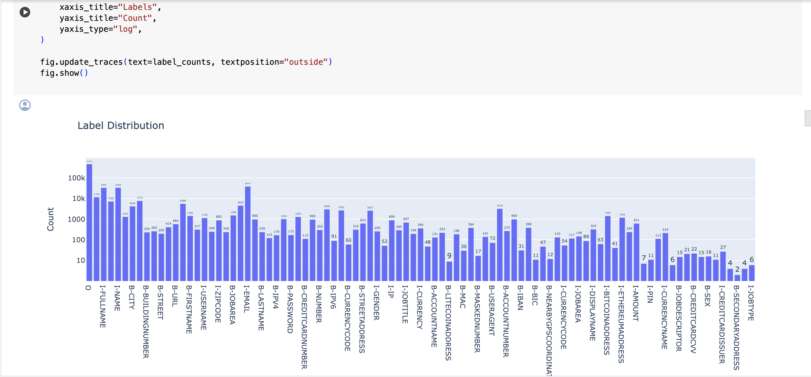
PII Tags Distribution
Notes:
We follow a B I O Tag system which means: Beginning, Inside and Outside
Here, some of the tags being used are shown
And some of the tags are ETH Wallet Address, Job Type, Currency, etc.

Slide 6
3. Solution Overview
Utilizes a DeBERTaV3 transformer backbone, known for its disentangled attention mechanism and strong contextual understanding
Fine-tuned for token-level classification on 93 PII entity types using the BIO tagging scheme
Mixed precision (FP16) enabled for memory and speed efficiency
Notes:
We use DeBERTaV3 as the backbone model — it’s a transformer architecture that’s well-regarded for its disentangled attention mechanism, which helps it better understand the relationship between words and their relative positions in context. This gives us stronger language modeling, especially for nuanced text like personal identifiers.
We fine-tuned the model specifically for token-level classification, using the BIO tagging scheme and it allows us to precisely label where PII entities start and end within a sequence.
To optimize both memory and inference time, we enabled mixed precision training using FP16 — that’s 16-bit floating point — which speeds up processing significantly while maintaining accuracy.

Slide 7
4. Model Architecture
DebertaV3 Backbone: The DebertaV3 model serves as the feature extractor, capturing the contextual relationships between words in the text.
Token-Level Classification: A dense layer is added on top of the DebertaV3 backbone to perform classification at the token level. This allows the model to assign a PII tag to each token in the input sequence.
Softmax Activation: The output of the dense layer is passed through a softmax activation function. This converts the logits into probabilities for each PII tag, facilitating the classification process.
Notes:
Let's break down our model architecture. At its core is the DeBERTaV3 transformer backbone, which uses a novel disentangled attention mechanism. Unlike traditional transformers that treat content and position equally, this separates content-to-content, content-to-position, and position-to-position attention. This allows the model to better understand phrases like 'John, residing at 123 Main St' where the relationship between name and address matters.
The token-level classification layer is where we map these rich contextual embeddings to our 93 PII tags. Each token in the 2,048-length sequence gets classified independently.
Finally, the softmax activation converts raw logits to probabilities. For example, it might assign 98% probability to [B-CREDITCARD] for a 16-digit number, but only 5% if that number appears in a math textbook context.

Slide 8
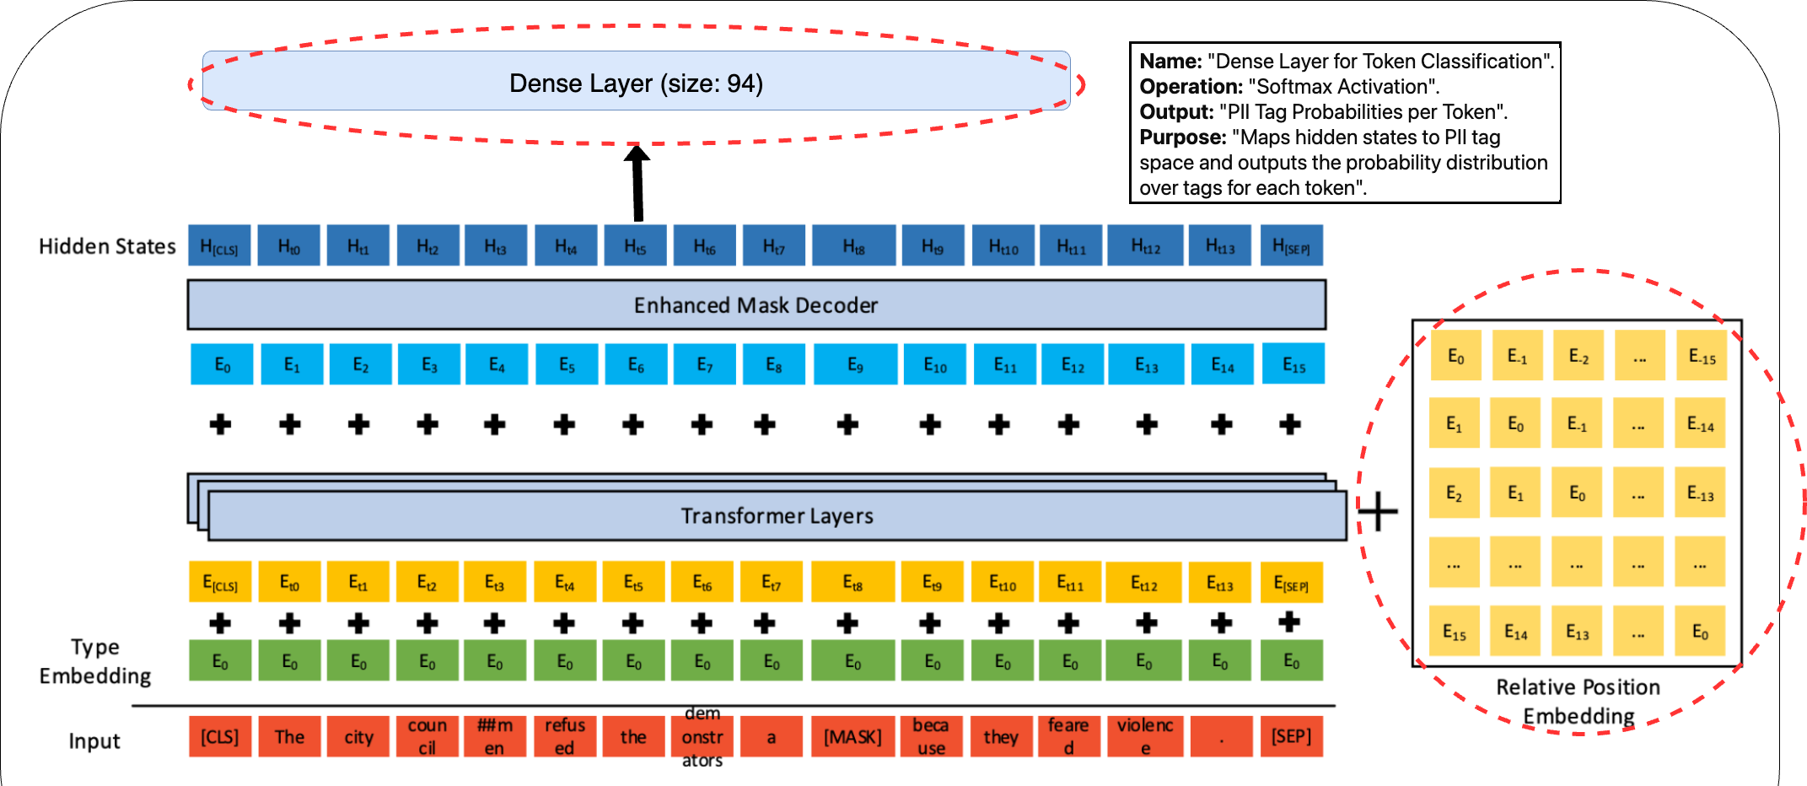
Architecture
Notes:
Input text is tokenized into subwords using DeBERTa's 128K vocabulary
Relative position embeddings (this purple layer) track distances between tokens – this is crucial when a patient's name appears on page 1 and their diagnosis on page 5 of a medical report
12 attention layers progressively build contextual understanding - early layers detect simple patterns like 16-digit credit cards, deeper layers handle complex cases like distinguishing between 'Python' (language) and 'Python' (snake species) in CVs
The classification head outputs per-token probabilities, which we threshold at 0.85 confidence to minimize false positives

Slide 9
5. Training and Evaluation
Custom Loss Function
Evaluation Metrics: The F1 score, is used as the primary metric for evaluating the model's performance as this metric balances precision and recall
Dynamic LR Scheduler: To support Adaptive Learning and employ a dynamic learning rate schedule to optimize model training.
Notes:
We have a custom Loss Function as a Modified Cross-Entropy implementation specially designed to ignore padding tokens (value -100) during loss calculation and focus optimization only on meaningful tokens in variable-length sequences. F1 Score is critical for PII detection where both false positives and false negatives carry significant costs and more suitable than accuracy for the imbalanced label distribution in PII detection.
Dynamic LR Scheduler Starts at 6.0e-06, peaks at 1.0e-05, with controlled decay to 7.75e-06 and it has an adaptive warm-up phase for stable gradient updates along with strategic rate reduction in later epochs to fine-tune model parameters.

Slide 10
Comparison
Feature | Traditional Methods | Proposed Solution
Context Handling | Typically ≤ 512 tokens (BERT-based models Source | Supports 2,048 token sequences with windowed attention optimization
Model Architecture | Static BiLSTM/CRF or basic transformers Source | 12-layer disentangled attention backbone with dynamic gradient accumulation
Training Efficiency | 8.1GB VRAM usage for BERT-Large (Source) | 4.8GB VRAM usage through mixed precision and checkpointing
PII Types Supported | 10 – 15 entity types | 93 BIO-formatted PII categories including crypto addresses, IPs, etc.
Notes:
Here’s a quick comparison of traditional methods vs our solution.
Traditional models like BERT handle only 512 tokens, which means they lose context in longer texts. Our model handles 2,048 tokens using overlapping chunks with windowed attention — keeping context while being efficient.
We use a more advanced 12-layer transformer with dynamic gradient updates, instead of basic BiLSTM or static models.
It’s also more efficient — using just 4.8GB of VRAM compared to 8.1GB for BERT-Large, thanks to mixed precision and checkpointing.
And finally, instead of just 10–15 PII types, our model supports 93 — including modern entities like crypto addresses and IPs.

Slide 11
6. Result Metrics
Model | F1 Score | Latency
Fastino PII (Source) | 96.94 | 257
Our Model | 99.36 | 4500 (Yet to be determined for the final)
Fastino Fine-tuned Gemini-1.5-Flash (Source) | 95.11 | 2450
Fine-tuned DeepSeekV3 (Shen et al., 2025) (Source) | 90.3 | 2812
Notes:
Our model achieved a 99.36 F1 score, which looks higher than Fastino’s 96.94%. But it’s important to note we’re using a stricter evaluation — we require exact span matches, while Fastino uses a relaxed metric that allows partial matches. So it’s not a direct comparison.
Latency-wise, our current number is around 4500ms, but that’s just an initial estimate. We’re still optimizing, and with better hardware and tuning, we expect that to go down significantly. Current latency is unoptimized and measured on baseline hardware; not directly comparable to industry models optimized for speed
Even compared to Fastino Gemini and Shen et al modified DeepSeek, our model leads in accuracy, showing strong performance across both precision and recall.

Slide 12
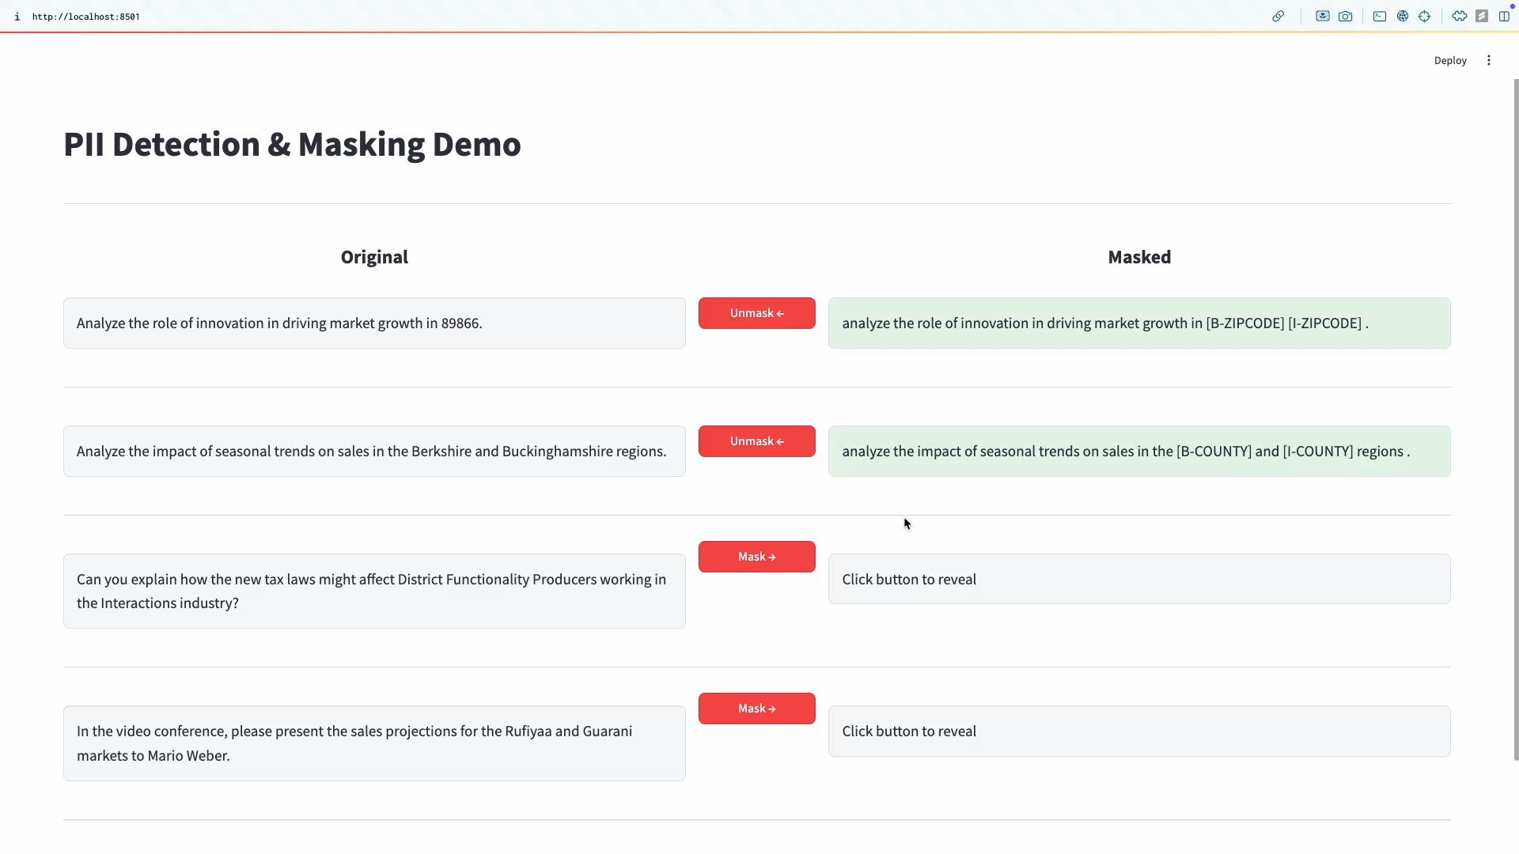
7. Results on Synthetic and PII43k Data
Notes:
This slide shows a quick demo of our model in action.
On the left, you can see the original input sentences containing PII. And on the right, you’ll see how our model detects and masks that information.
The video plays through a few examples — notice how ZIP codes, counties, names, and other entities are all accurately masked using BIO labels like [B-ZIPCODE].
It gives a clear, visual idea of how well the system performs on both synthetic and real PII43k data.

Slide 13
8. Conclusion and Future Work
Impact on Privacy Protection: We emphasize the importance of our work in enhancing privacy protection measures. By detecting a broader range of PII tags, our model contributes to more effective compliance with data privacy regulations and reduces the risk of privacy breaches.
Future Directions: Extend the model to support multiple languages, optimize the architecture for real-time and edge deployment and improve generalization to new domains by integrating unsupervised domain adaptation.
Limitations 1. Multilingual and Informal Texts 2. Computational Resources 3. Domain and Data Dependence 4. Robustness to Adversarial Inputs
Notes:
To wrap up — our model helps enhance privacy protection by detecting a wider range of PII types, improving compliance and reducing breach risks.
That said, we do have limitations — like challenges with informal or multilingual text, high compute needs, and reliance on specific domains.
Looking ahead, we plan to expand to multiple languages, optimize for real-time use, and improve adaptability through unsupervised domain adaptation.

